Slide 1
Flowchart

Slide 2
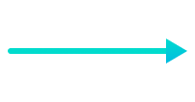


Flowchart Symbols
Symbol | Purpose | Description
 | Flow line | Indicates the flow of logic by connecting symbols.
 | Terminal(Stop/Start) | Represents the start and the end of a flowchart.
 | Input/Output | Used for input and output operation.

Slide 3





Flowchart Symbols
 | Processing | Used for arithmetic operations and data-manipulations.
 | Decision | Used for decision making between two or more alternatives.
 | On-page Connector | Used to join different flowline
 | Off-page Connector | Used to connect the flowchart portion on a different page.
 | Predefined Process/Function | Represents a group of statements performing one processing task.

Slide 4
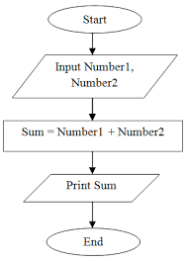
Adding 2 numbers

Slide 5
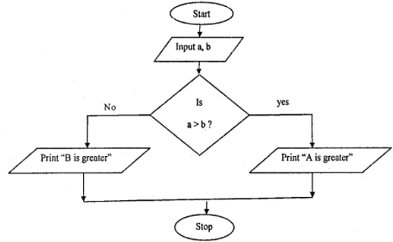
Largest of 2 numbers

Slide 6
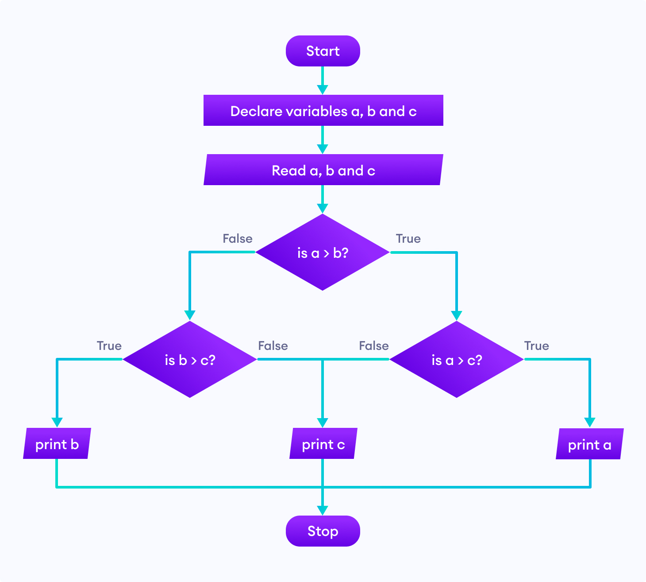
Largest of 3 numbers

Slide 7
Identifiers
Names given to various program elements (variables, constants, functions)
May consist of letters, digits and the underscore (‘_’) character, with no space between.
First character must be a letter or underscore.
There cannot be two successive underscores.
Keywords cannot be used as identifiers.
An identifier can be arbitrary long. Some C compilers recognize only the first few characters of the name (16 or 31).
Case sensitive ‘area’, ‘AREA’ and ‘Area’ are all different.

Slide 8
Valid and Invalid Identifiers
Valid
X
Abc
simple_interest
_emp_1
a123
LIST
stud_nameEmpl_3
Empl_2avg_empl_salary
Invalid
10abc
my-name
“hello”
simple interest
(area)
%rate

